Slide 1
Dividend Decision
Presented by [Name]

Slide 2
Dividend
Dividend is defined as the distribution of a portion of a company’s earnings, decided by the board of directors, to a class of its shareholders.
The dividend is most often quoted in terms of the dollar amount each share receives (dividend per share).

Slide 3
Conti..
Dividends are usually given as cash (cash dividend), but they can also take the form of stock (stock dividend) or other property.
Dividends provide an incentive to own stock in stable companies even if they are not experiencing much growth.
Companies are not required to pay dividends.

Slide 4
Dividend Decision – An Important Financial Management Decision
Dividend decision determines the division of earnings between payments to shareholders and retained earnings.
The Dividend Decision, in Corporate finance, is a decision made by the directors of a company about the amount and timing of any cash payments made to the company’s stockholders.
The dividend decision, is closely linked to both investment and financing decisions.

Slide 5
Types of Dividend Payment
Cash dividend
Bonus Shares referred to as stock dividend
Property dividend

Slide 6
Basic Dividend Policies
Constant Rate of Dividend: As per this policy, the firm pays a dividend at a fixed rate on the paid-up share capital. If this policy is pursued, the shareholders are more or less sure on the earnings on their investment.
Constant Percentage of Earnings: A firm may pay dividend at a constant rate on earnings. Since payment of dividend depends on the current earnings, the payment of dividend will rise in the year the firm is earning higher profit and the dividend payment will be lower in the year in which the profit falls.

Slide 7
Conti…
Stable Rupee Dividend plus Extra Dividend: Under this policy, a firm pays fixed dividend to the shareholders.
In the year, the firm is earning higher profits it pays extra dividend over and above the regular dividend.
When the normal condition returns, the firm begins to pay normal dividend by cutting down the extra dividend.

Slide 8
Factor Affecting Dividend
Amount of Earnings
Growth Opportunities
Cash flow Position
Shareholders' Preference
Access to Capital Market
Stock Market Reaction

Slide 9
Dividend Theories
There are conflicting opinions regarding the impact of dividends on the valuation of a firm.
According to one school of thought, dividends are irrelevant so that the amount of dividend paid has no effect on the valuation of a firm. (IRRELEVANCE THEORY)
On the other hand, certain theories consider the dividend decision as relevant to the value of the firm measured in terms of the market price of the shares. (RELEVANCE THEORY)

Slide 10
Relevance of dividends
The dividend decision is relevant. There are two theories which support the relevance of dividends namely:
Walter’s model
Gordon’s Model

Slide 11
Walter Model
James Walter has proposed a model of share valuation which supports the view that the dividend policy of the firm has a bearing on share valuation.
His model is based on the following assumptions:
The firm is an all-equity financed entity. Further, it will rely only on retained earnings to finance its future investments.
The rate of return on investments and cost of capital are constant.
100% payout or retention
The firm has an infinite life.

Slide 12

Conti…
Walter’s formula to determine the market price per share is as follows:
Where
P is the price per equity share
D is the dividend per share
E is the earnings per share
(E − D) is the retained earnings per share
r is the rate of return on investments
k is the cost of equity

Slide 13

Conti…
As per the Walter’s formula, the price per share is a sum of two components.
The first component is the present value of an infinite stream of dividends
the second component is the present value of an infinite streams of returns from retained earnings

Slide 14
Conti…
numerical examples for the Walter model for three cases:
growth firm (r>k)
normal firm (r=k)
declining firm (r<k)

Slide 15
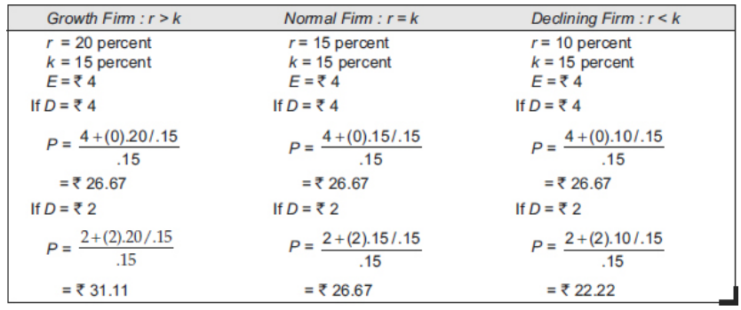
Example

Slide 16
Implications of Walter Model
When the rate of return is greater than the cost of capital (r > k), the price per share increases as the dividend payout ratio decreases.
When the rate of return is equal to the cost of capital (r = k), the price per share does not vary with changes in dividend payout ratio.
When the rate of return is less than the cost of capital (r < k), the price per share increases as the dividend payout ratio increases.
Thus the Walter model implies that:
The optimal payout ratio for a growth firm (r > k) is nil.
The optimal payout ratio for a normal firm (r = k) is irrelevant.
The optimal payout ratio for a declining firm (r < k) is 100 percent.

Slide 17
Gordon Model
Myron Gordon proposed a model of stock valuation using the dividend capitalisation approach. His model is based on the following assumptions:
All Equity firm
No external financing
Constant rate of return and cost of capital
Constant retention
Cost of capital greater than the growth rate
Perpetual earning

Slide 18

Conti…
Gordon’s valuation formula is
where
P0 is the price per share at the end of year 0,
E1 is the earnings per share at the end of year 1,
b is the fraction of earnings the firm retains,
k is the rate of return required by the shareholders,
r is the rate of return earned on investments made by the firm, and
br is the growth rate of earnings and dividends.

Slide 19
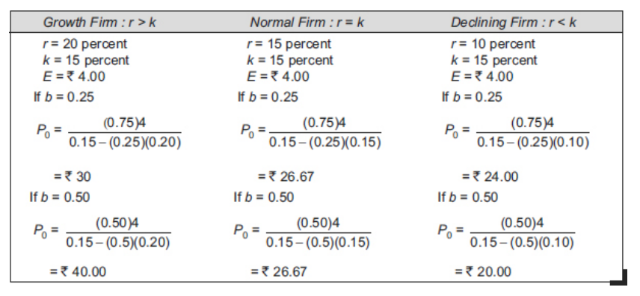
Example

Slide 20
Example
The earning per share of a company is Rs 10. It has an internal rate of return of 15% and capitalization rate of its risk class is 12.5%. If walter’s model is used.
What should be the optimum pay-out of the firm.
What would be the price of share at this pay-out.

Slide 21
Example
A company has a total investment of 500000 in assets and 50000 outstanding equity share at Rs. 10 per share. It earns a rate of 15% on its investment and has a policy of retaining 50% of the earning. If the appropriate discount rate of the firm is 10%, determine the price of share using Gordon’s model. What shall happen to the price of the share if company has a payout 80%?

